Slide 1
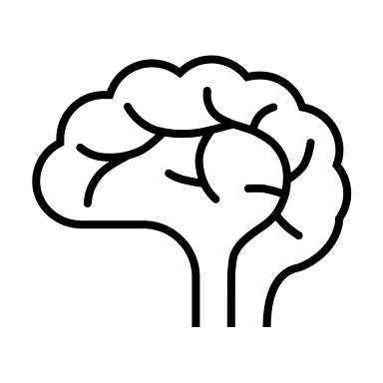
Machine Learning for Neuroscience
Diffusion Models
Payam Barnaghi
Department of Brain Sciences
Imperial College London
Spring 2023
The main content are adapted from: Ch. 18, Understanding Deep Learning, Simon J.D. Prince, MIT Press.
Notes:
1

Slide 2
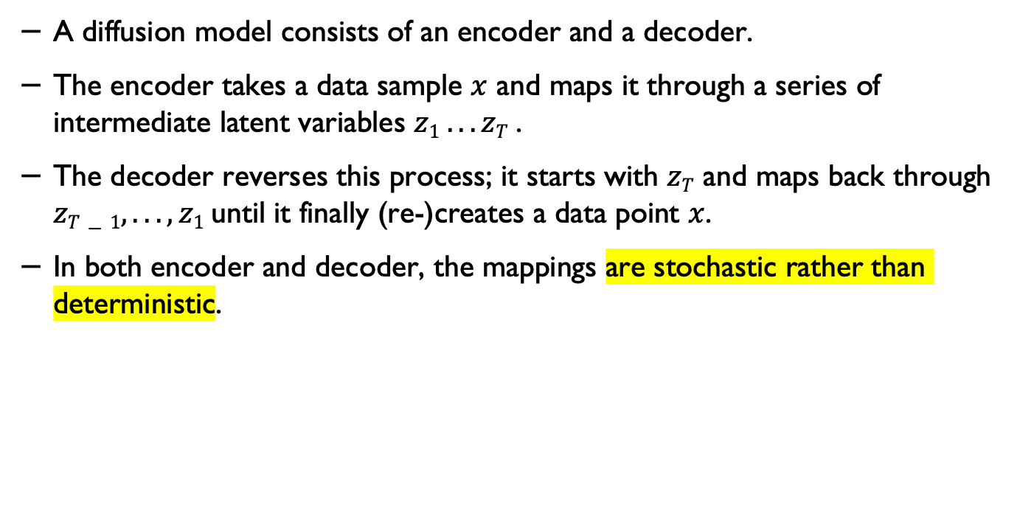
Diffusion models
A diffusion model consists of an encoder and a decoder.
The encoder takes a data sample $x$ and maps it through a series of intermediate latent variables $z1 . . . zT$.
The decoder reverses this process; it starts with $zT$ and maps back through $zT−1, . . . , z1$until it finally (re-)creates a data point $x$.
In both encoder and decoder, the mappings are stochastic rather than deterministic.
Understanding Deep Learning, Simon J.D. Prince, MIT Press.

Slide 3

Generative models
Source: Lilian Weng, What are Diffusion Models?, https://lilianweng.github.io/posts/2021-07-11-diffusion-models/

Slide 4
Diffusion models
Diffusion models work by successively adding noise (Gaussian noise) to the training data, and then learning to reconstruct the data by reversing this process.
Diffusion models are parameterised Markov chains models trained to gradually denoise data.
After training, we can use the diffusion model to generate data by simply passing randomly sampled noise through the learned denoising process.
Chadha, Aman and Jain, Vinija, Diffusion Models, Distilled AI, 2020, https://aman.ai

Slide 5
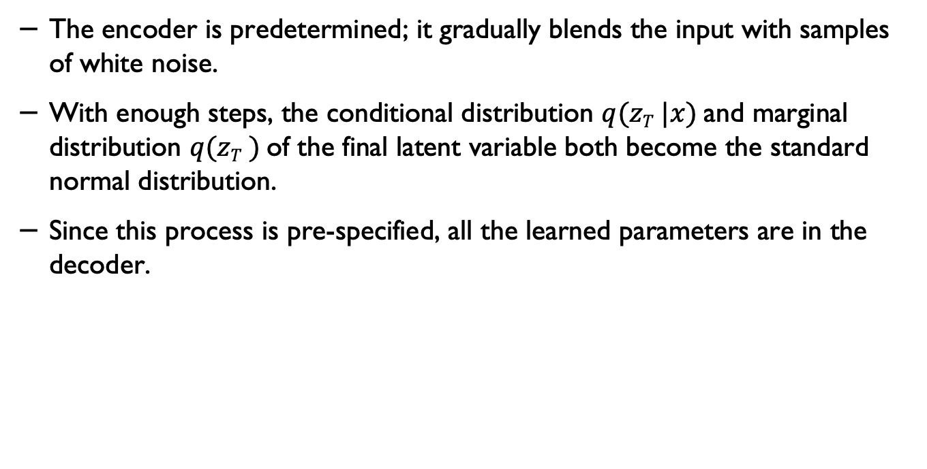
The encoder in diffusion models
The encoder is predetermined; it gradually blends the input with samples of white noise.
With enough steps, the conditional distribution $q(zT |x)$and marginal distribution $q(zT )$of the final latent variable both become the standard normal distribution.
Since this process is pre-specified, all the learned parameters are in the decoder.

Slide 6
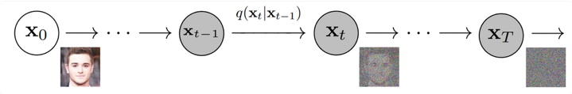
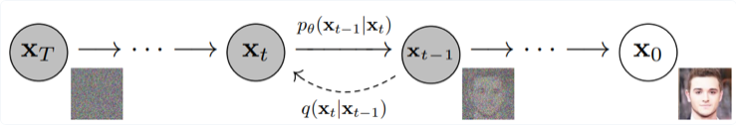
Diffusion models
Source: Ho et al,. https://arxiv.org/pdf/2006.11239.pdf via
Chadha, Aman and Jain, Vinija, Diffusion Models, Distilled AI, 2020, https://aman.ai

Slide 7
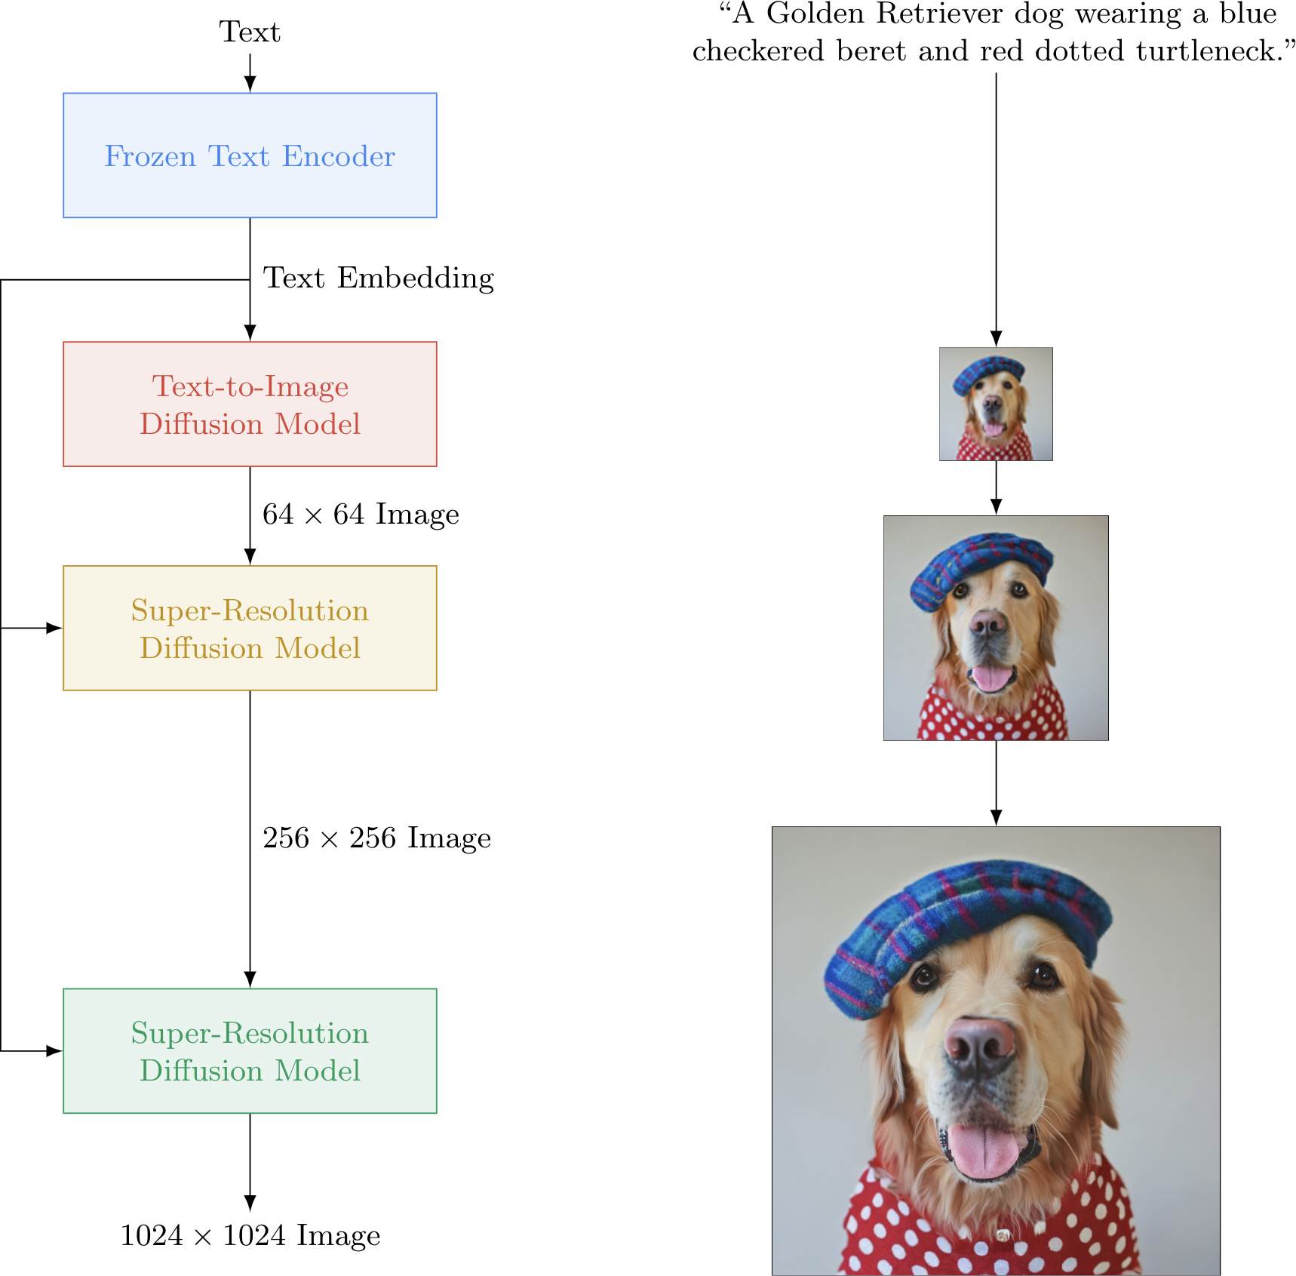
End-to-end models
Saharia et al., https://imagen.research.google

Slide 8
The process
Both the forward and reverse process (both indexed with t) continue for a duration of finite time steps T (Ho et al. use T =1000).
One will start off with t=0 and sample a real image x₀ from the data.
Then continue with the forward process and sample some noise from a Gaussian distribution at each time step t.
This will be added to the image of the previous time step.
Given a sufficiently large T and a continuous process of adding noise at each time step, you will end up with t=T.
Chadha, Aman and Jain, Vinija, Diffusion Models, Distilled AI, 2020, https://aman.ai

Slide 9
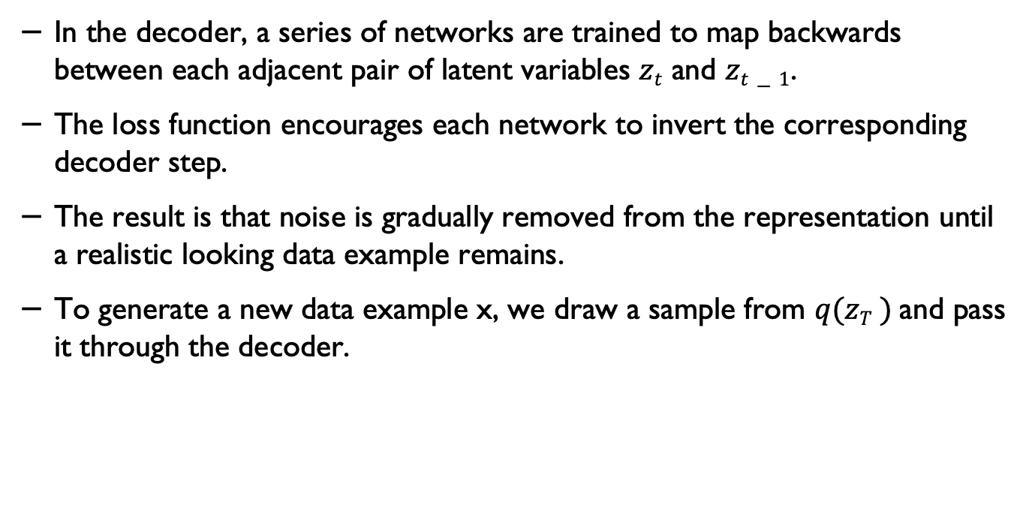
The decoder in diffusion models
In the decoder, a series of networks are trained to map backwards between each adjacent pair of latent variables $zt$ and $zt−1$.
The loss function encourages each network to invert the corresponding decoder step.
The result is that noise is gradually removed from the representation until a realistic looking data example remains.
To generate a new data example x, we draw a sample from $q(zT )$and pass it through the decoder.

Slide 10
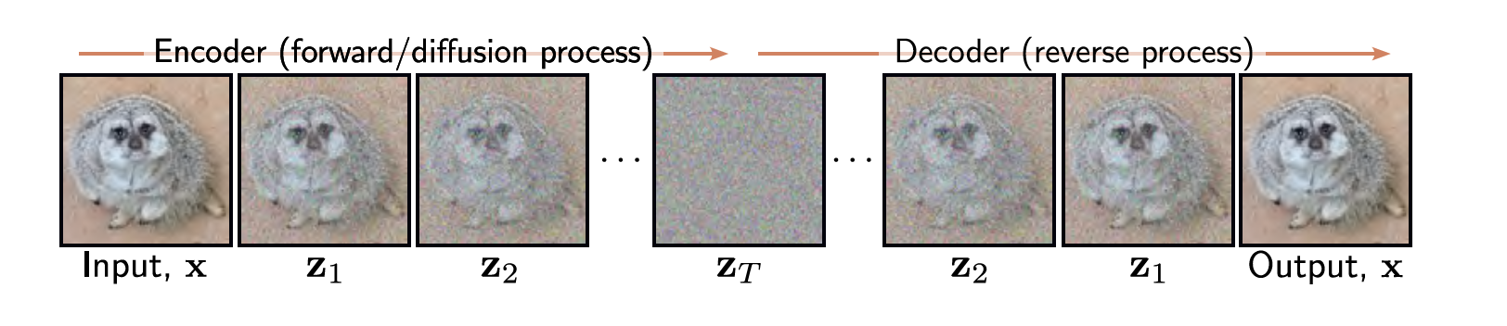
Diffusion models
Understanding Deep Learning, Simon J.D. Prince, MIT Press.

Slide 11
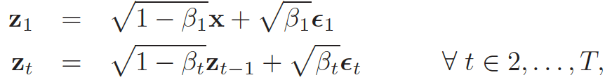
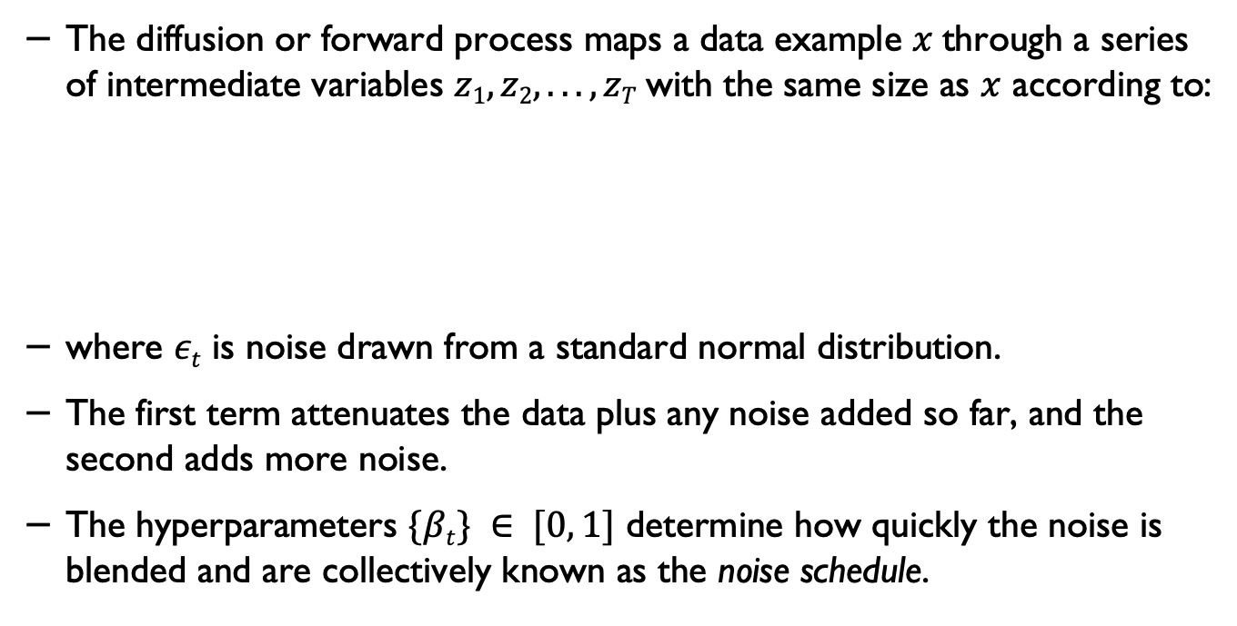
Diffusion forward process
The diffusion or forward process maps a data example $x$through a series of intermediate variables $z1, z2, . . . , zT$with the same size as $x$ according to:
where $εt$ is noise drawn from a standard normal distribution.
The first term attenuates the data plus any noise added so far, and the second adds more noise.
The hyperparameters $\{βt\} ∈ [0, 1]$ determine how quickly the noise is blended and are collectively known as the noise schedule.
Understanding Deep Learning, Simon J.D. Prince, MIT Press.

Slide 12
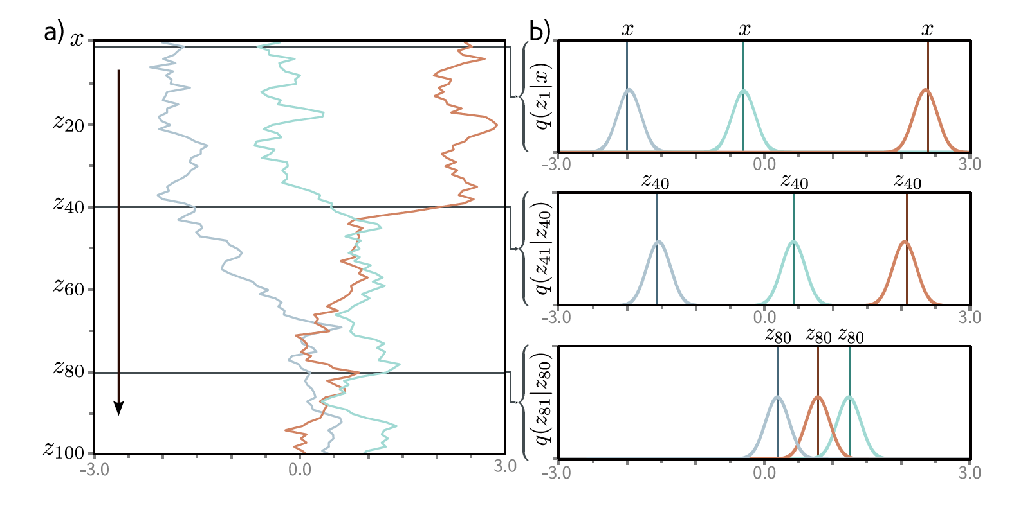
Forward process
Understanding Deep Learning, Simon J.D. Prince, MIT Press.

Slide 13
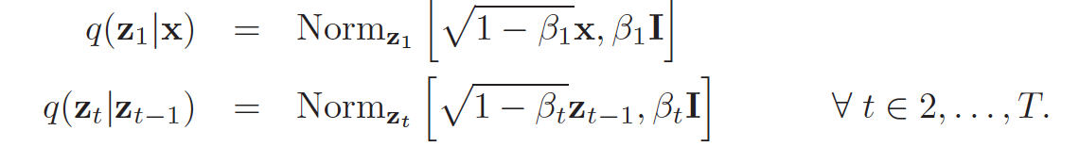
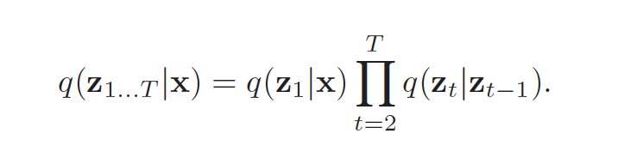
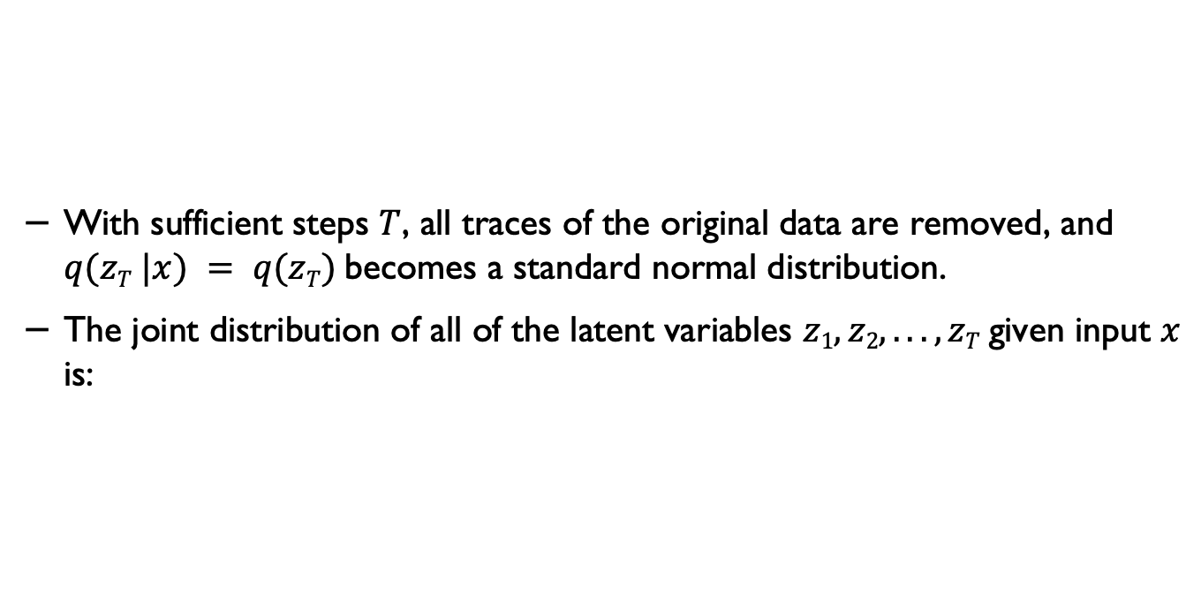
Forward process
With sufficient steps $T$, all traces of the original data are removed, and $q(zT |x) = q(zT)$becomes a standard normal distribution.
The joint distribution of all of the latent variables $z1, z2, . . . , zT$given input $x$ is:
Understanding Deep Learning, Simon J.D. Prince, MIT Press.

Slide 14
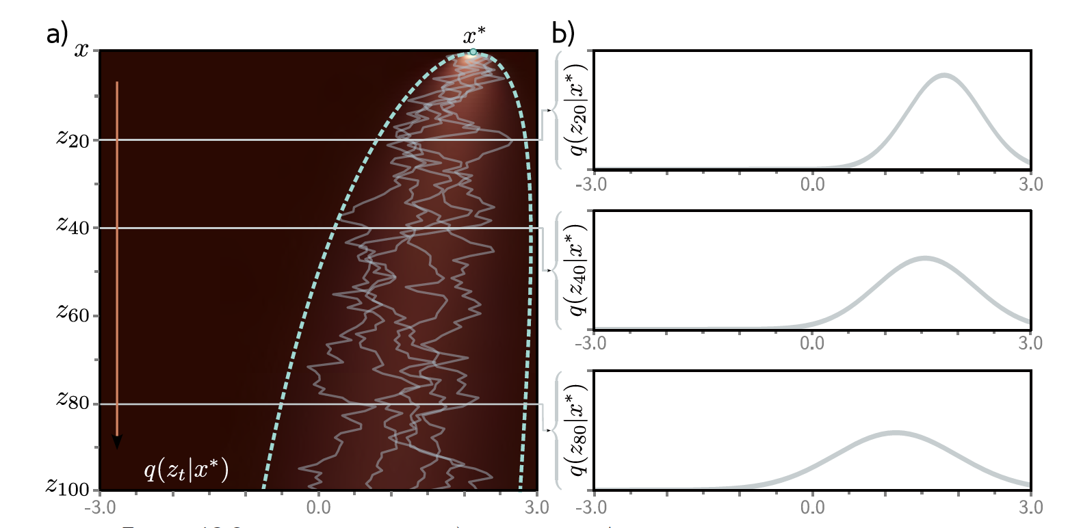
Diffusion kernel
Understanding Deep Learning, Simon J.D. Prince, MIT Press.

Slide 15
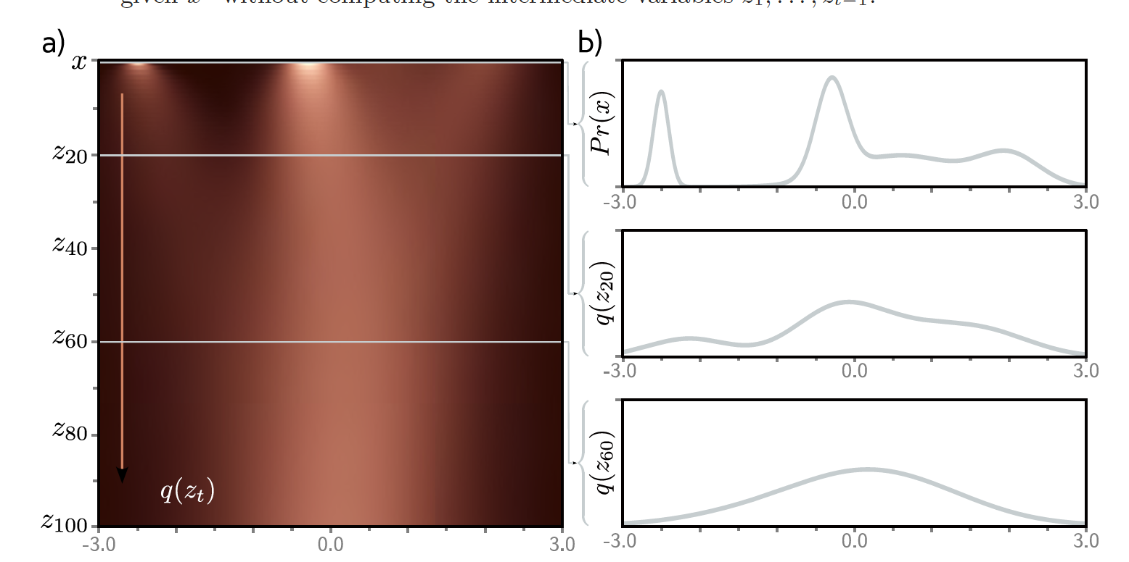
Marginal distributions
Understanding Deep Learning, Simon J.D. Prince, MIT Press.

Slide 16
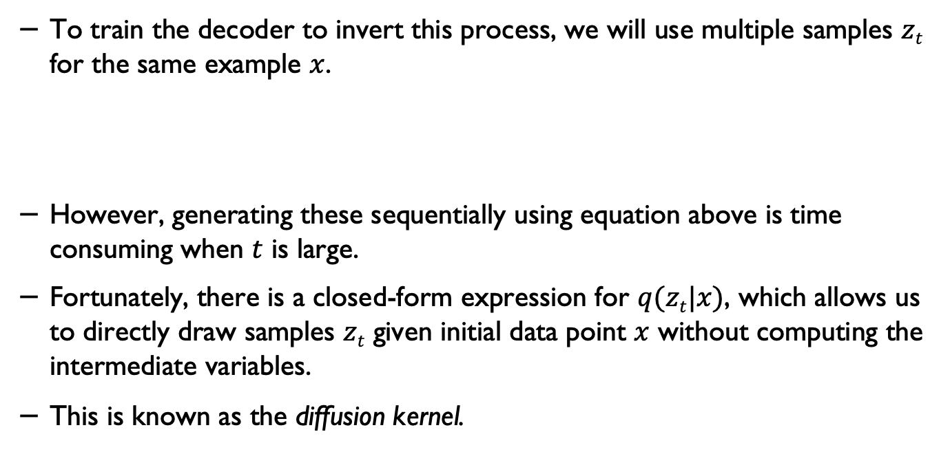
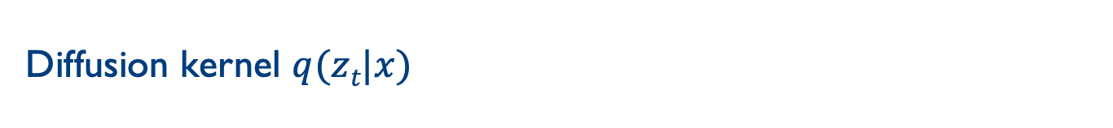
Diffusion kernel $q(zt|x)$
To train the decoder to invert this process, we will use multiple samples $zt$ for the same example $x$.
However, generating these sequentially using equation above is time consuming when $t$ is large.
Fortunately, there is a closed-form expression for $q(zt|x)$, which allows us to directly draw samples $zt$ given initial data point $x$ without computing the intermediate variables.
This is known as the diffusion kernel.
Understanding Deep Learning, Simon J.D. Prince, MIT Press.

Slide 17
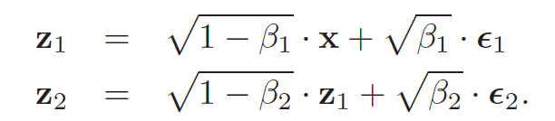
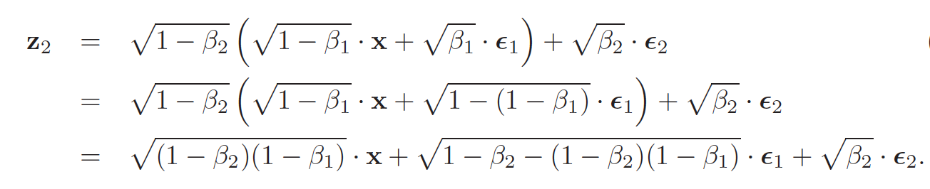
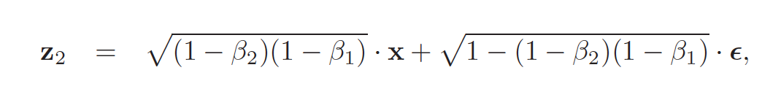
Determining intermediate z
Understanding Deep Learning, Simon J.D. Prince, MIT Press.

Slide 18
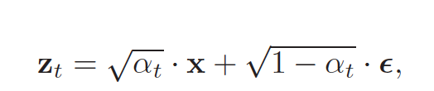
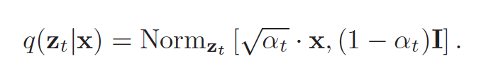
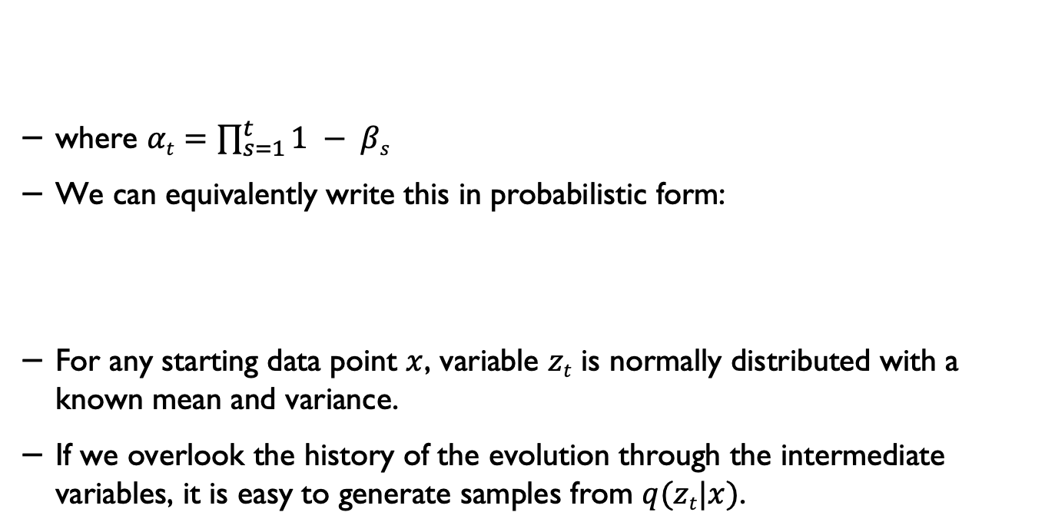
Diffusion kernel $q(zt|x)$
where $αt=\prod_{s=1}^{t}{1 − βs}$
We can equivalently write this in probabilistic form:
For any starting data point $x$, variable $zt$ is normally distributed with a known mean and variance.
If we overlook the history of the evolution through the intermediate variables, it is easy to generate samples from $q(zt|x)$.
Understanding Deep Learning, Simon J.D. Prince, MIT Press.

Slide 19
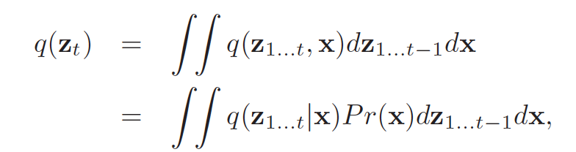
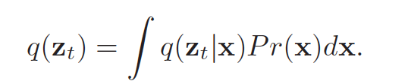
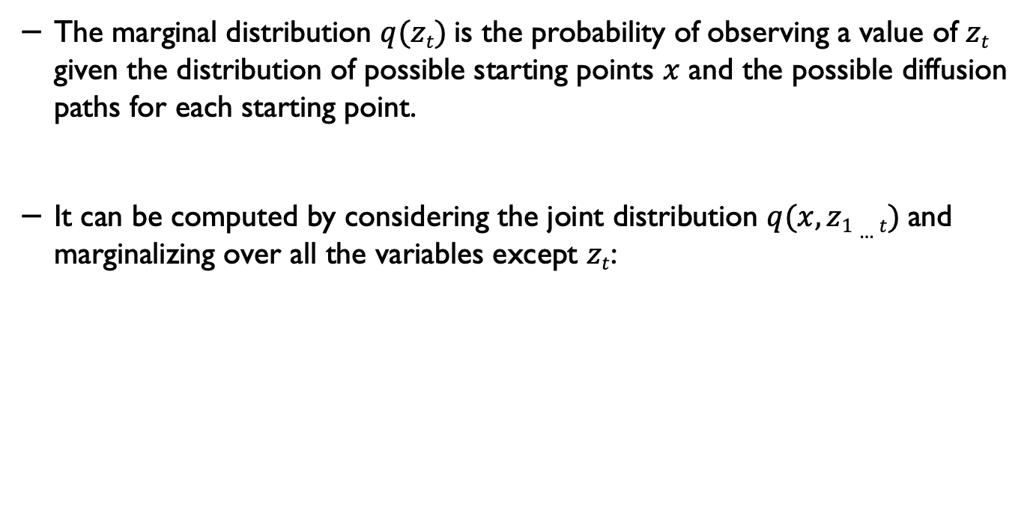
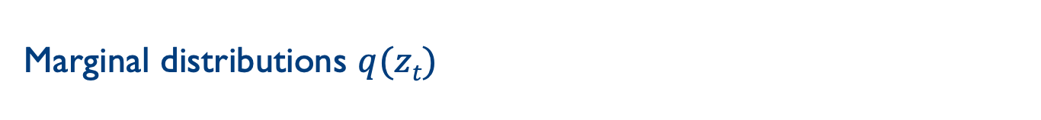
Marginal distributions $q(zt)$
The marginal distribution $q(zt)$is the probability of observing a value of $zt$ given the distribution of possible starting points $x$ and the possible diffusion paths for each starting point.
It can be computed by considering the joint distribution $q(x, z1…t)$and marginalizing over all the variables except $zt$:
Understanding Deep Learning, Simon J.D. Prince, MIT Press.

Slide 20
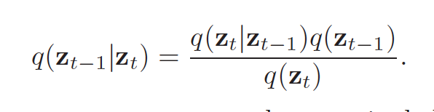
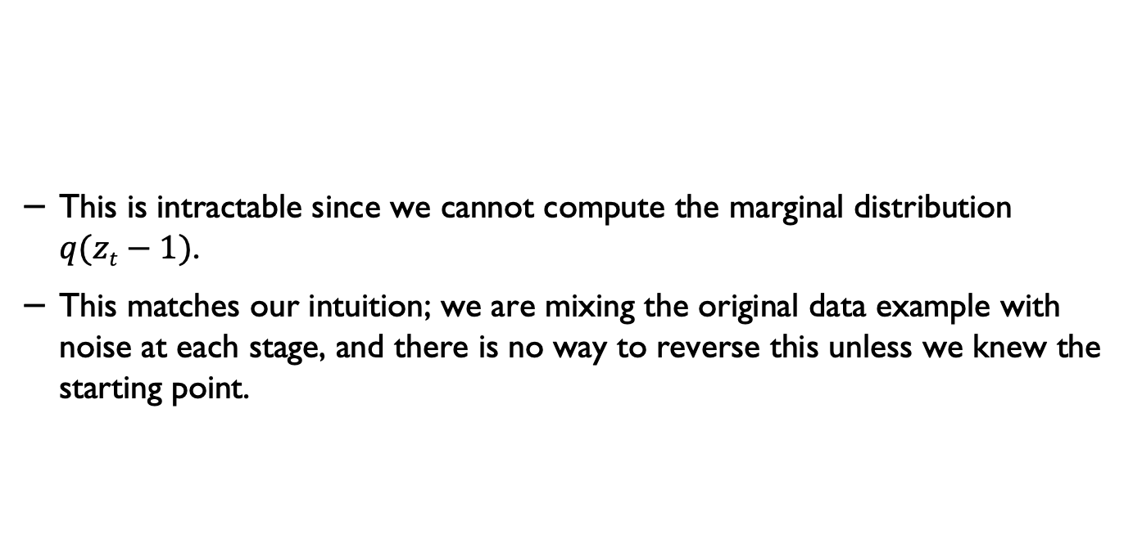
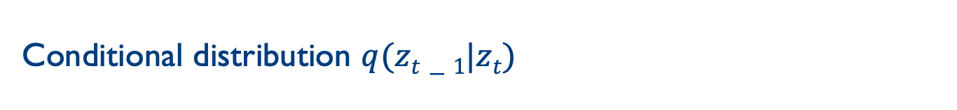
Conditional distribution $q(zt−1|zt)$
This is intractable since we cannot compute the marginal distribution $q(zt−1)$.
This matches our intuition; we are mixing the original data example with noise at each stage, and there is no way to reverse this unless we knew the starting point.
Understanding Deep Learning, Simon J.D. Prince, MIT Press.

Slide 21
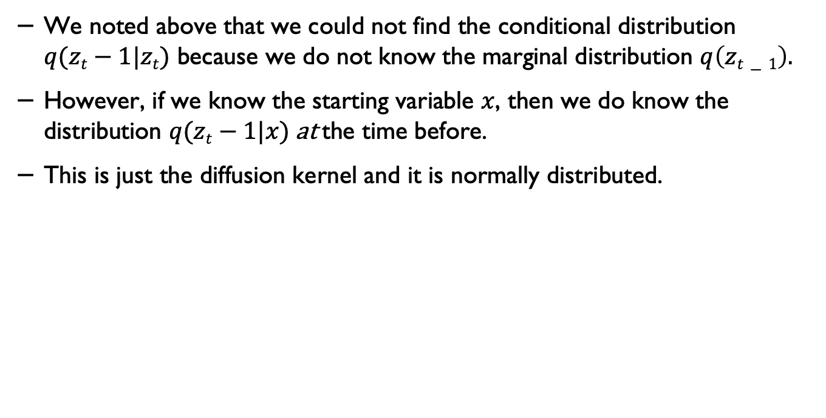
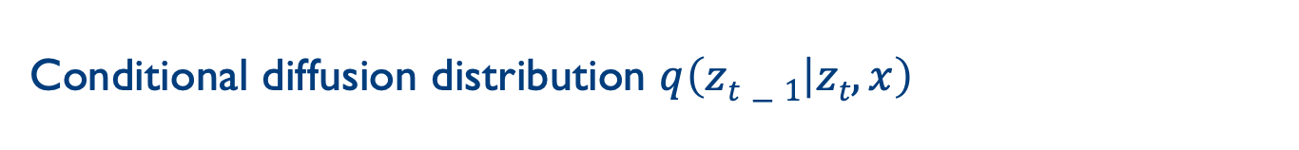
Conditional diffusion distribution $q\left(zt−1 | zt,x\right)$
We noted above that we could not find the conditional distribution $q(zt−1|zt)$ because we do not know the marginal distribution $q\left(zt−1\right).$
However, if we know the starting variable $x$, then we do know the distribution $q(zt−1|x)$at the time before.
This is just the diffusion kernel and it is normally distributed.
Understanding Deep Learning, Simon J.D. Prince, MIT Press.

Slide 22
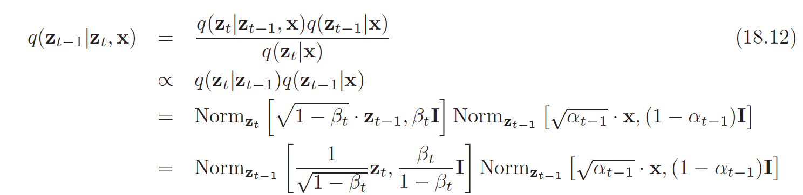
Conditional diffusion distribution $q\left(zt−1 | zt,x\right)$
Understanding Deep Learning, Simon J.D. Prince, MIT Press.

Slide 23
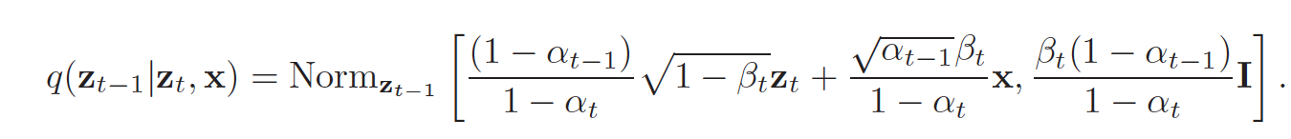
Conditional diffusion distribution $q\left(zt−1 | zt,x\right)$
Understanding Deep Learning, Simon J.D. Prince, MIT Press.

Slide 24
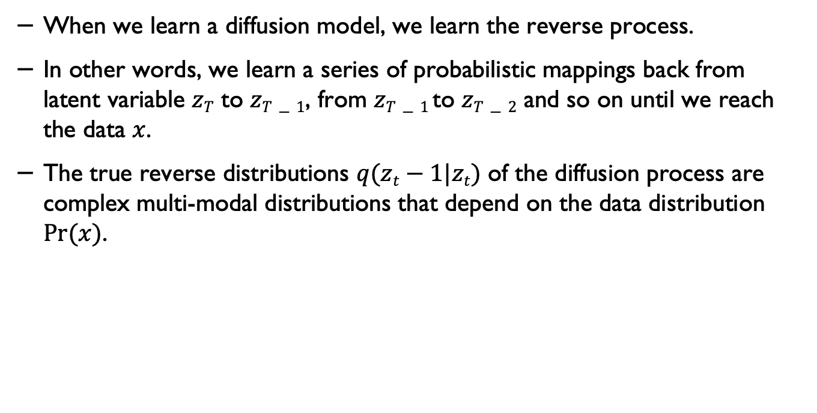
Decoder (reverse process)
When we learn a diffusion model, we learn the reverse process.
In other words, we learn a series of probabilistic mappings back from latent variable $zT$ to $zT−1$, from $zT−1$to $zT−2$ and so on until we reach the data $x$.
The true reverse distributions $q(zt−1|zt)$ of the diffusion process are complex multi-modal distributions that depend on the data distribution $Pr⁡(x)$.
Understanding Deep Learning, Simon J.D. Prince, MIT Press.

Slide 25
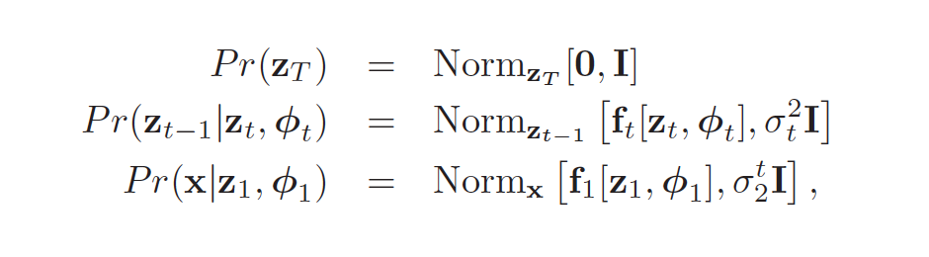
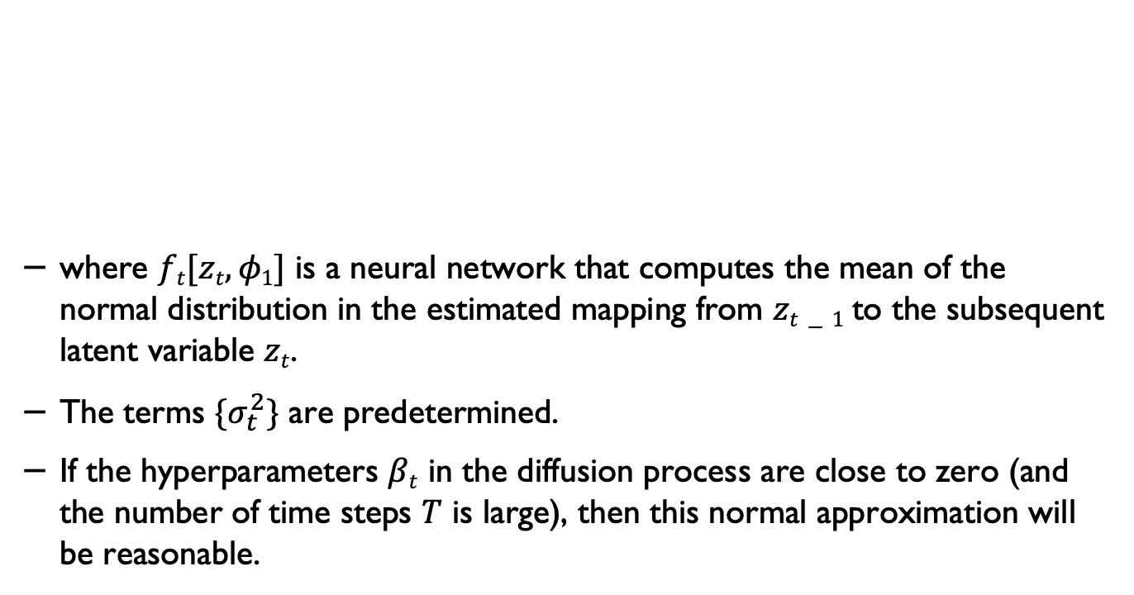
Decoder (reverse process)
where $ft[zt,φ1]$ is a neural network that computes the mean of the normal distribution in the estimated mapping from $zt−1$to the subsequent latent variable $zt$.
The terms $\{σ_{t}^{2}\}$ are predetermined.
If the hyperparameters $βt$ in the diffusion process are close to zero (and the number of time steps $T$ is large), then this normal approximation will be reasonable.
Understanding Deep Learning, Simon J.D. Prince, MIT Press.

Slide 26
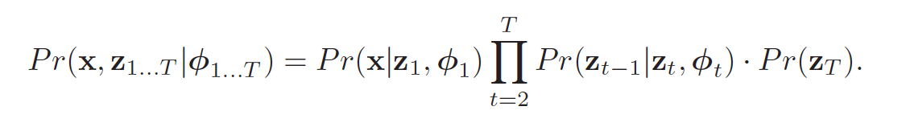
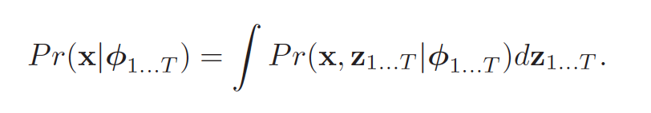
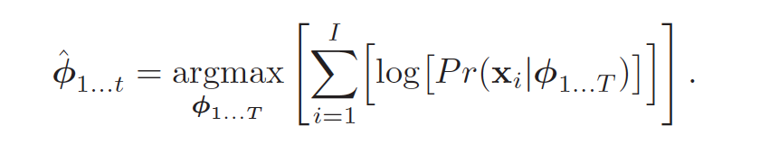
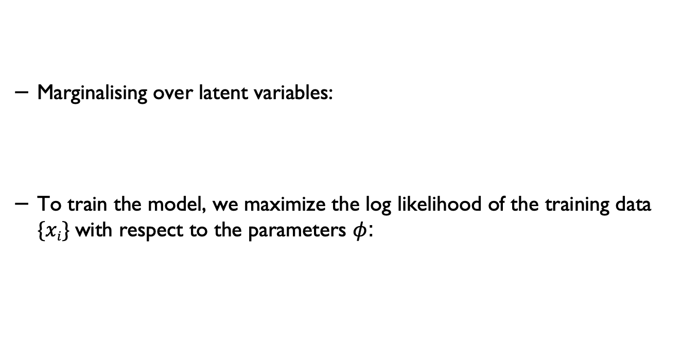
Training*
Marginalising over latent variables:
To train the model, we maximize the log likelihood of the training data $\{xi\}$with respect to the parameters $φ$:
Understanding Deep Learning, Simon J.D. Prince, MIT Press.

Slide 27
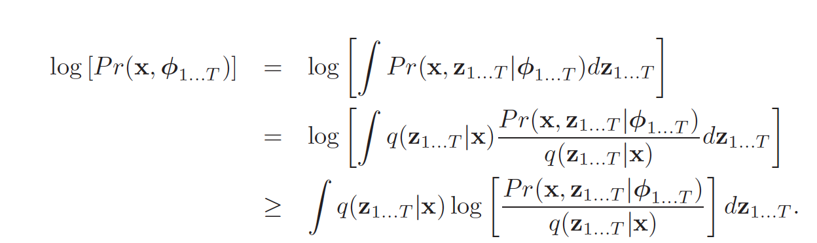
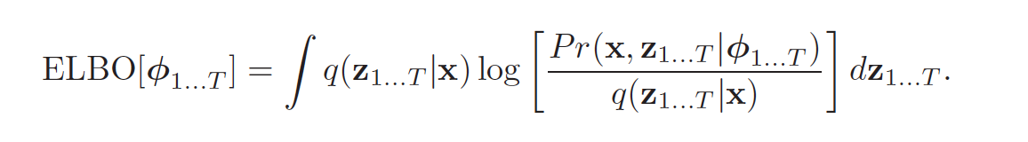
Evidence lower bound (ELBO)*
Understanding Deep Learning, Simon J.D. Prince, MIT Press.

Slide 28
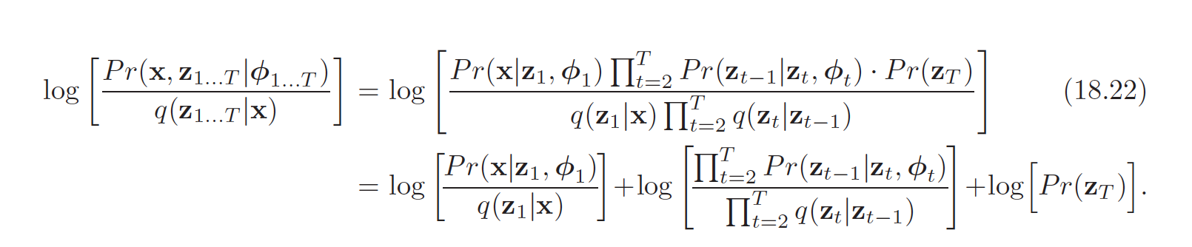
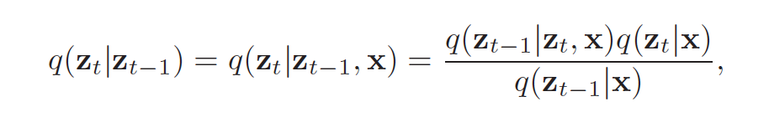
Simplifying the ELBO*
Understanding Deep Learning, Simon J.D. Prince, MIT Press.

Slide 29
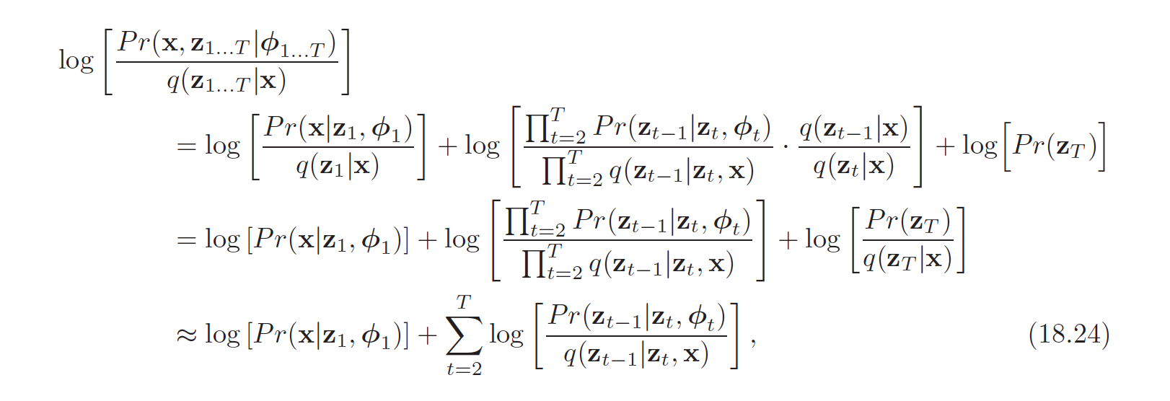
Simplifying the ELBO**
Understanding Deep Learning, Simon J.D. Prince, MIT Press.

Slide 30
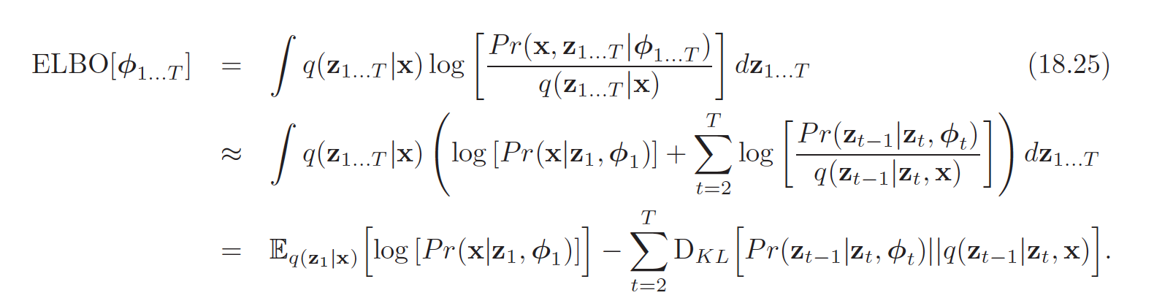
The ELBO**

Slide 31
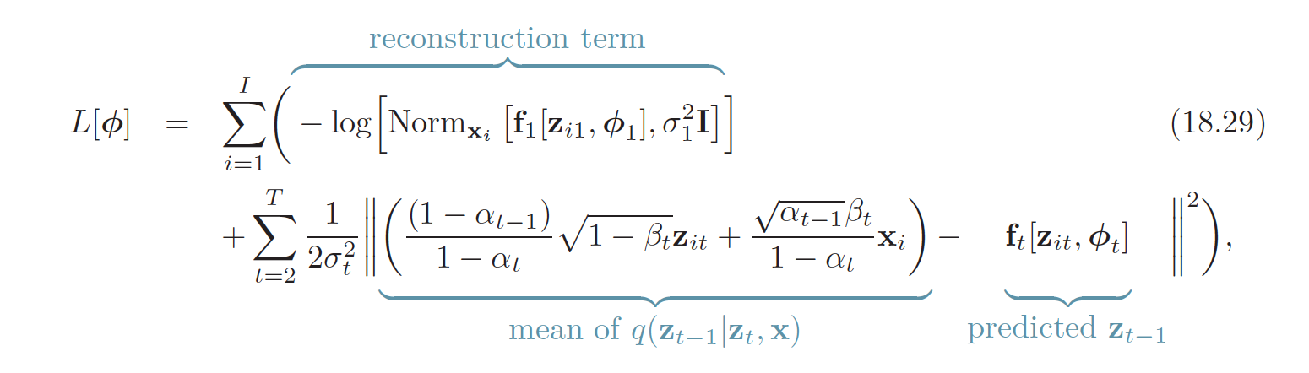
Diffusion Loss
Understanding Deep Learning, Simon J.D. Prince, MIT Press.

Slide 32
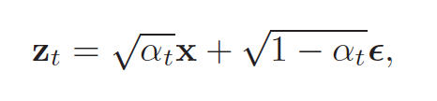

Re-parameterisation
Understanding Deep Learning, Simon J.D. Prince, MIT Press.

Slide 33

The Loss function***
Understanding Deep Learning, Simon J.D. Prince, MIT Press.

Slide 34

Diffusion algorithm
Understanding Deep Learning, Simon J.D. Prince, MIT Press.

Slide 35

Sampling

Slide 36
Network architecture
The only requirement for the model is that its input and output dimensionality are identical.
The neural network needs to take in a noised image at a particular time step and return the predicted noise.
The predicted noise here is a tensor that has the same size and resolution as the input image.
The neural networks takes in tensors and returns tensors of the same shape. Given this restriction, it is perhaps unsurprising that image diffusion models are commonly implemented with U-Net-like architectures.
Chadha, Aman and Jain, Vinija, Diffusion Models, Distilled AI, 2020, https://aman.ai

Slide 37

U-Net

Slide 38
Reverse process
The path along the reverse process consists of many transformations under continuous conditional Gaussian distributions.
At the end of the reverse process, we are trying to produce an image, which is composed of integer pixel values.
Therefore, we must devise a way to obtain discrete (log) likelihoods for each possible pixel value across all pixels.
Chadha, Aman and Jain, Vinija, Diffusion Models, Distilled AI, 2020, https://aman.ai

Slide 39

The reverse process
The way that this is done is by setting the last transition in the reverse diffusion chain to an independent discrete decoder.
To determine the likelihood of a given image x₀ given x₁₁, we first impose independence between the data dimensions:
where D is the dimensionality of the data and the superscript i indicates the extraction of one coordinate.
Chadha, Aman and Jain, Vinija, Diffusion Models, Distilled AI, 2020, https://aman.ai

Slide 40


Noise prediction
The goal now is to determine how likely each integer value is for a given pixel given the distribution across possible values for the corresponding pixel in the slightly noised image at time t=1 :
where the pixel distributions for t=1 are derived from the below multivariate Gaussian whose diagonal covariance matrix allows us to split the distribution into a product of univariate Gaussians, one for each dimension of the data:
Chadha, Aman and Jain, Vinija, Diffusion Models, Distilled AI, 2020, https://aman.ai

Slide 41

Noise prediction
We assume that the images consist of integers in $0,1,…,255$ (as standard RGB images) which have been scaled linearly to $[−1,1]$.
We then break down the real line into small “buckets”, where, for a given scaled pixel value x, the bucket for that range is $[x−1/255,x+1/255]$.
The probability of a pixel value $x$, given the univariate Gaussian distribution of the corresponding pixel in $x1$, is the area under that univariate Gaussian distribution within the bucket centred at $x$.
Chadha, Aman and Jain, Vinija, Diffusion Models, Distilled AI, 2020, https://aman.ai

Slide 42

Predicting noise
Ho et al. found that predicating the noise at each given time step provides better performance.
Jonathan Ho et al., Denoising Diffusion Probabilistic Models,https://arxiv.org/abs/2006.11239

Slide 43
It turns out you may not even need any of these

Slide 44

Masked Generative Transformers
Huiwen Chng et al., Muse: Text-To-Image Generation via Masked Generative Transformers, Google Research
https://muse-model.github.io

Slide 45
Acknowledgements
The main content are adapted from: Chapter 18, Understanding Deep Learning, Simon J.D. Prince, to be published by MIT Press.

Slide 46
If you have any questions
Please feel free to come and see me (9th Floor, Sir Michael Uren Research Hub, White City Campus) or email (p.barnaghi@imperial.ac.uk).

